Slide 1
Family Preparedness and
Self-reliance
30 August 2026

Slide 2
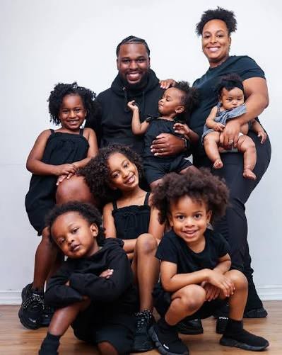
Family Preparedness because it’s based on family
Personal family
Neighborhood family
Ward family
Extended or remote family
Assigned family

Slide 3
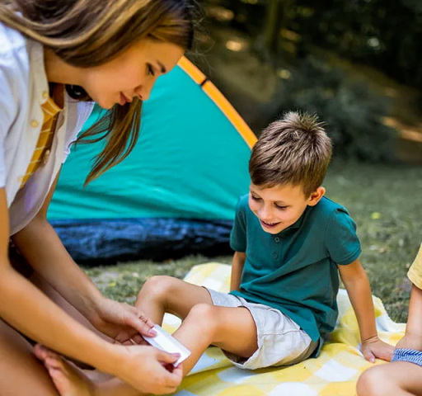
Our purpose
Raise awareness
Invite all to be prepared
Prepared for what?
small inconveniences
injuries and medical incidents
large financial events
disaster or major loss

Slide 4
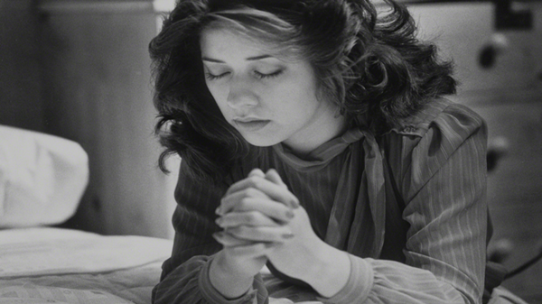
Prepared in what ways?
Spiritually and temporally
But all preparedness is spiritual (D&C 29:34)
Involve the Lord from the start (Alma 37:37)
Seek ye first the Kingdom of God
It’s a process, not an event
Whether or not it’s an emergency
Not my intention to cover all what-ifs

Slide 5
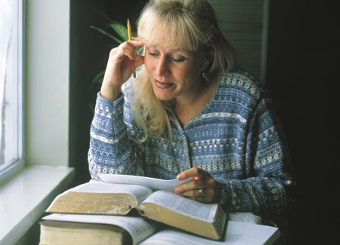
Spiritual preparedness
Personal habits
prayer
scriptures
living the Gospel
Weekly church attendance
Non-temple ordinances
Temple ordinances

Slide 6
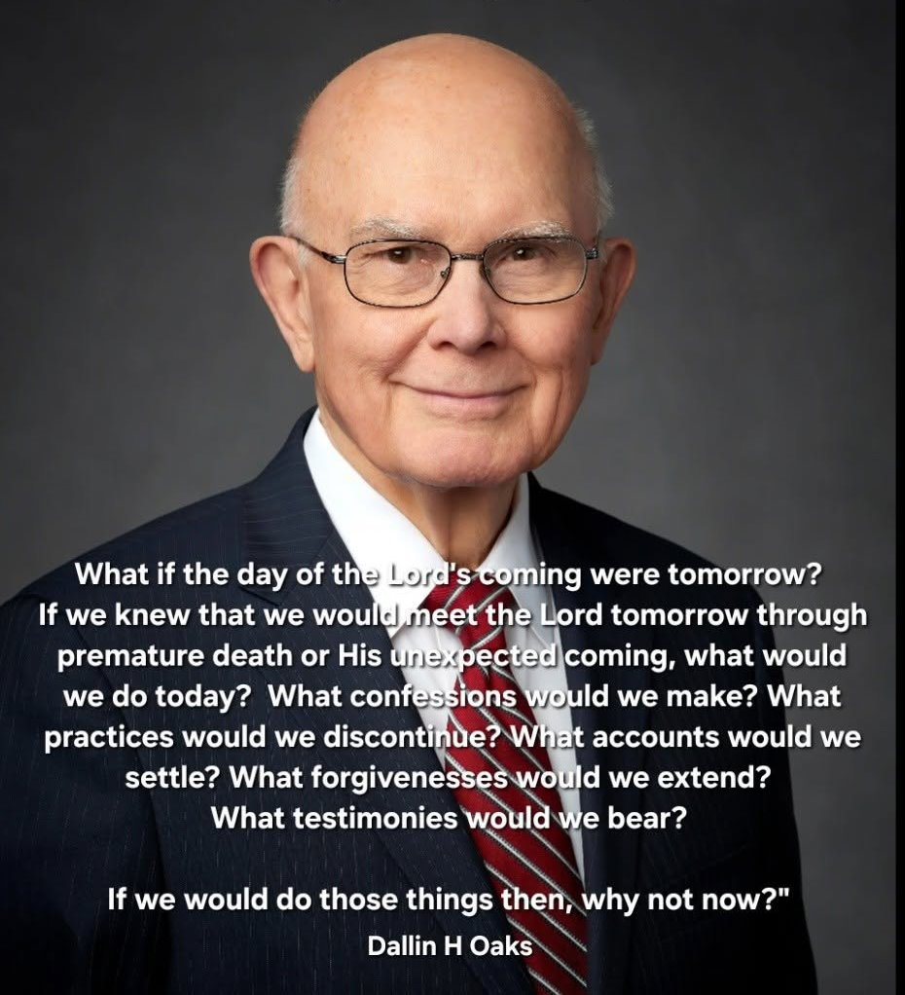
May 2004
A 72-hour kit of temporal supplies may prove valuable for earthly challenges, but…a 24-hour kit of spiritual preparation is of greater and more enduring value.
– Elder Dallin H. Oaks

Slide 7
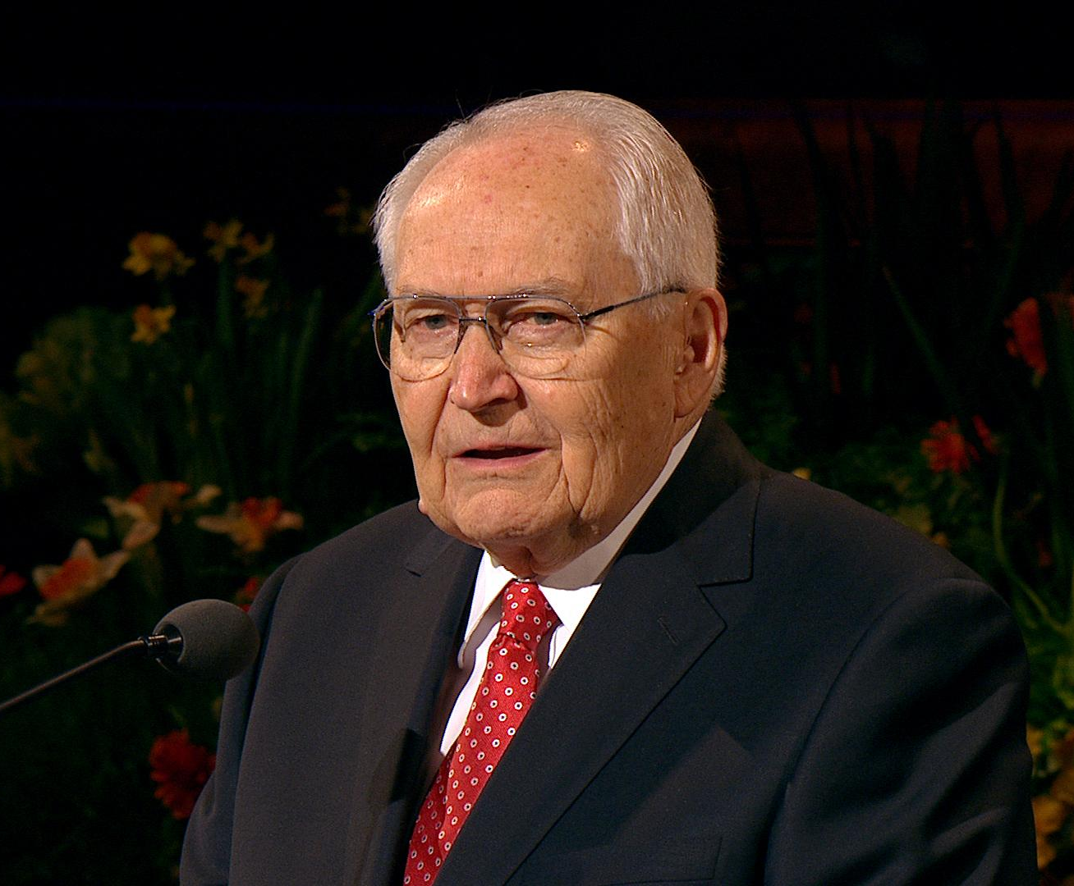
November 1995
The need for preparation is abundantly clear. The great blessing of being prepared gives us freedom from fear.
– Elder L. Tom Perry

Slide 8
Temporal preparedness
Physical
medical
disability
transportation
Emotional
mental, trauma
Educational
formal (GDE, college)
skills (trade, training)
Financial
Vocational (job, extension)
Disaster
power / electricity / gas / fuel
housing / shelter / safety
food and water
heating / cooling
clothing
communication
special needs / pets
waste / sewage / garbage

Slide 9
Self-reliance
As much as possible, we must take responsibility for our own well-being
Financial security, budgeting
Educational goals, literacy
Vocational stability, work
Physical health
Emotional resiliency

Slide 10
Self-sufficiency implies self-reliance
Don’t be completely dependent on others, if possible
It’s ok to be partially dependent on others; that’s what makes a community
Even when you’re on your own, you’re not alone

Slide 11
Prepare reasonably
Start small, don’t over-spend; something’s better than nothing
Make a 72-hour kit
Do or collect more as time and resources become available
Learn a survival skill
Food gardening, canning, storing, preparation
First aid, ABCs
Handyman (electrical, plumbing, damage, fire, gas, flood)
Water collection, purification, storage
Do not attempt to attain preparedness perfection

Slide 12
What kinds of disruptions
flat tire
lost your job
home theft
hang nail
property damage
need a pizza now
power / water outage
earthquake
Take a deep breath
Allow your training to kick in
Inform others, accept help from others

Slide 13
Disaster possibilities
(none of these are likely where we live)
Services are so overwhelmed that help is possibly unavailable for long periods
Earthquake
Flood
Fire
Chemical spill
Terrorist attack
Severe storm
Cyber attack
Pandemic
Landslide
Explosion

Slide 14
If a disaster should occur
Remain calm (comes with practice)
Check yourself for injuries
Check household members and pets
Call 911, depending on the event
Check your place for damage
Check in with your Block Captain
Check your neighbors and ministering families
Inform an out-of-state contact to call others
Turn on your radio (145.670 MHz) and check in

Slide 15
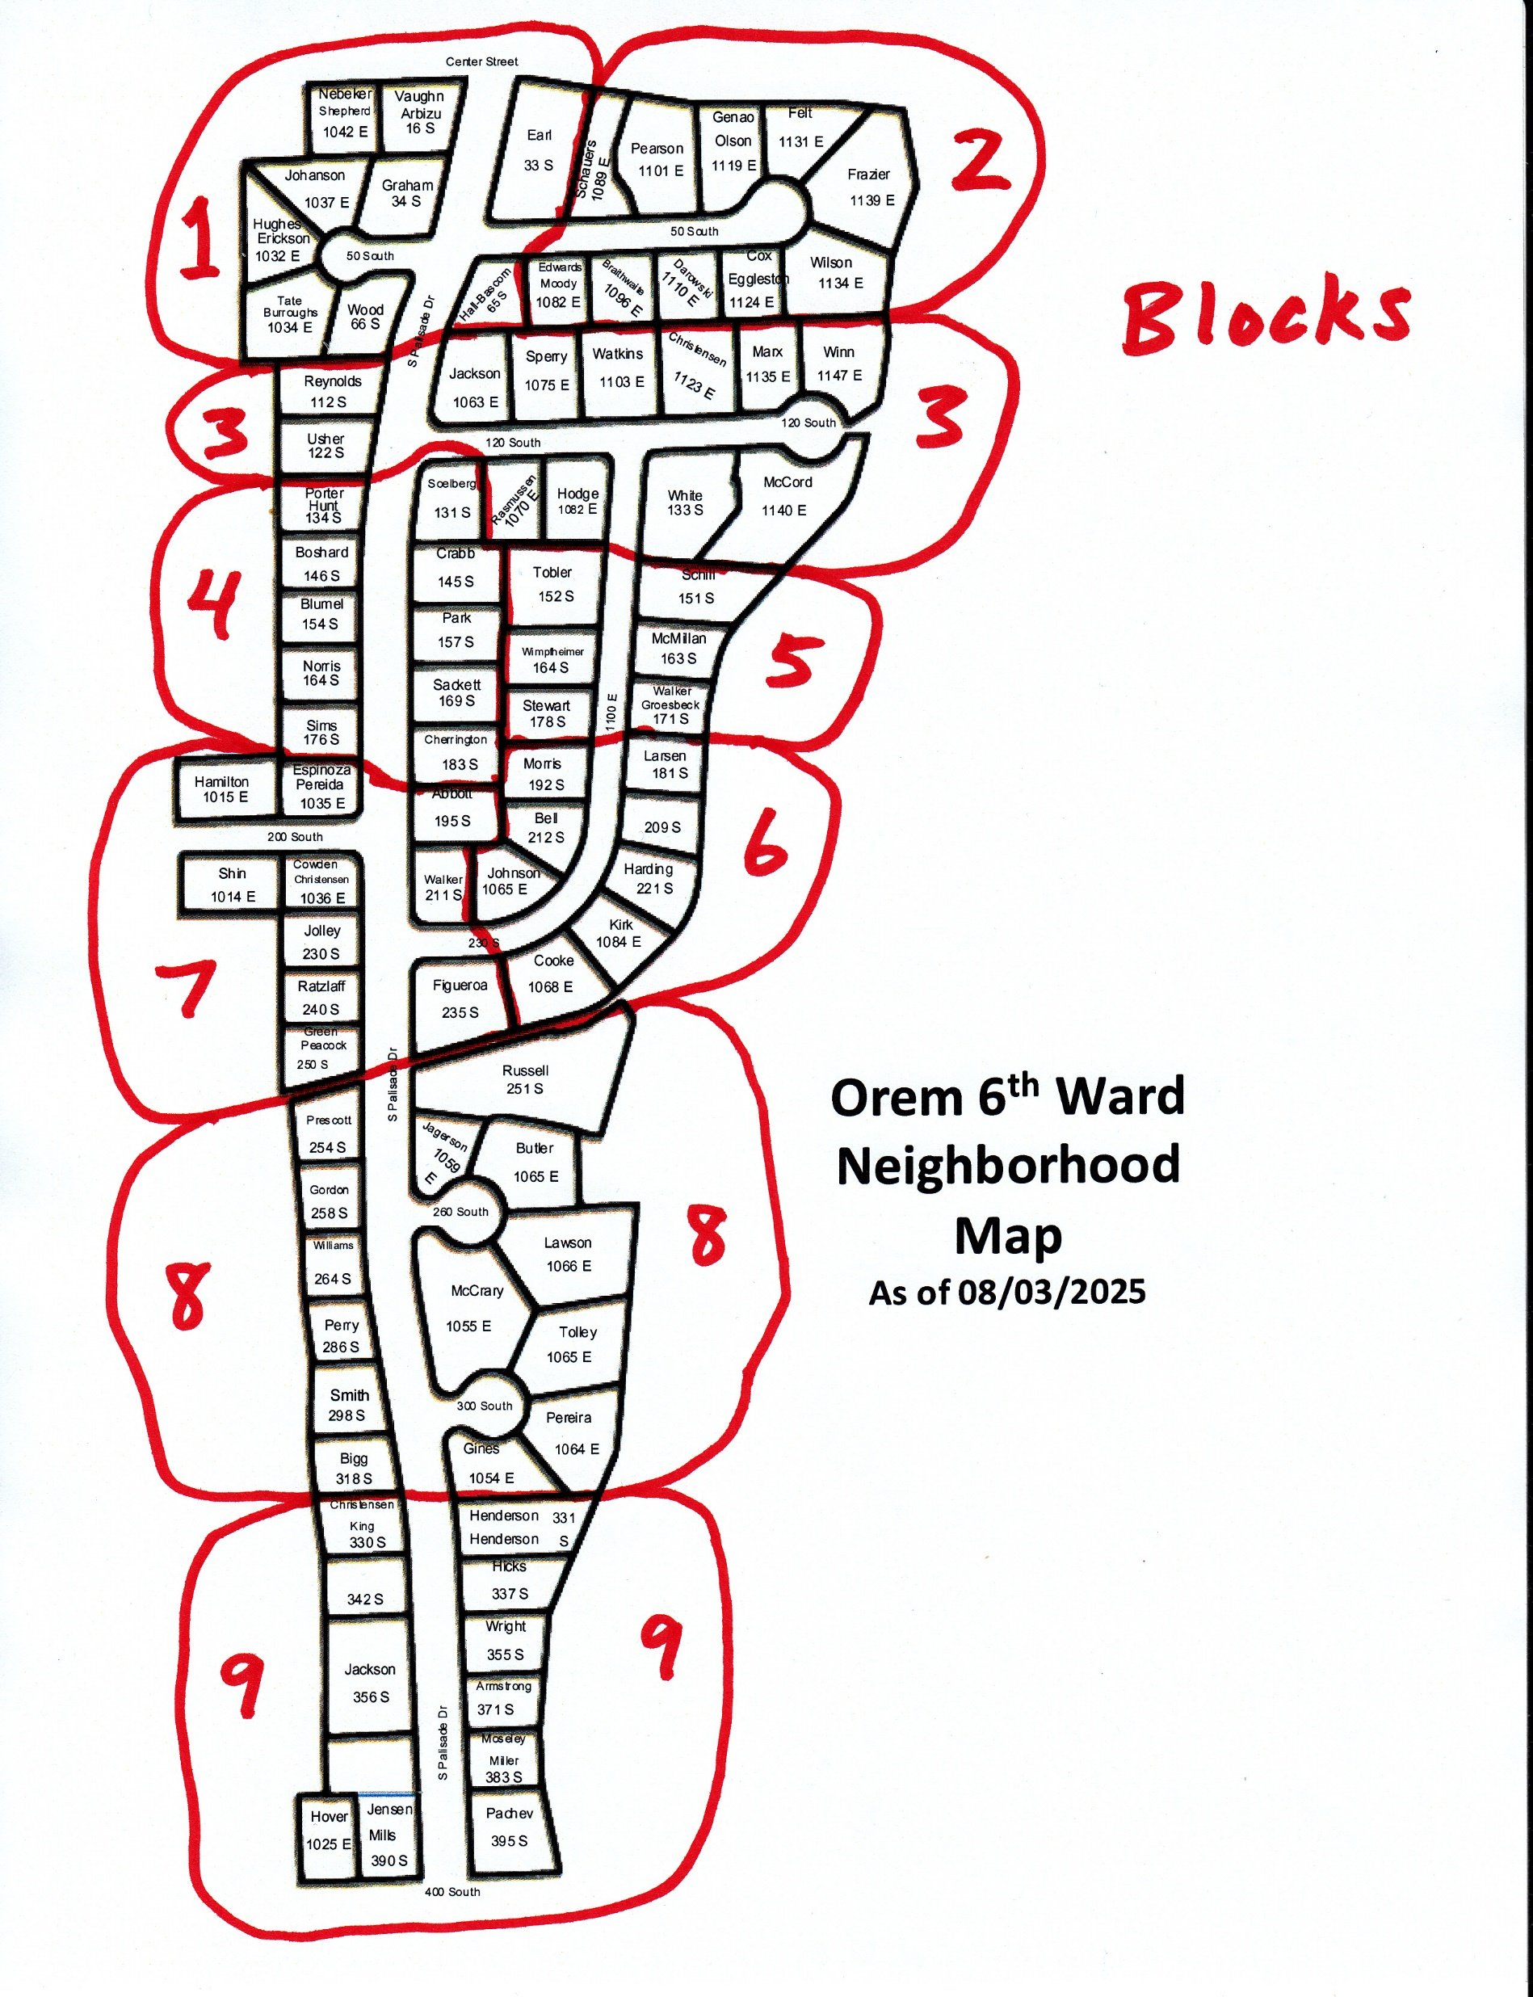
Our Blocks
1 = Katrina Johansen
2 = Justin Schauers
3 = Danny Sperry
4 = Joe Blumel
5 = Brent Tobler
6 = Taylor Larsen
7 = Trina Peacock
8 = Janet Tolley
9 = Gary Hicks

Slide 16
If you need to leave
Tell your Block Captain
Grab your 72-hour kit
Call in your intention by radio (145.670 MHz) if the phone system is unavailable
Go to the agreed gathering location
Make reunification one of your objectives

Slide 17
Make a preparedness plan
As a family, discuss how you can be better prepared for disruptions
Decide what kinds of disruptions you should prepare for
Ask your ministering brothers and sister how they are planning, then ask them for ideas
Discuss in which ways your plan could improve
Set goals on making those improvements

Slide 18
Orem City Drill
At 6: 00 pm on Thursday 24 September 2026 the City of Orem will be holding a city-wide communication drill to ensure the city population can be accounted for in a timely manner.
Your Block Captain will contact you if you do not text them your whereabouts first.
Sign up for city and county text alerts at alerts.utahcounty.gov

Slide 19
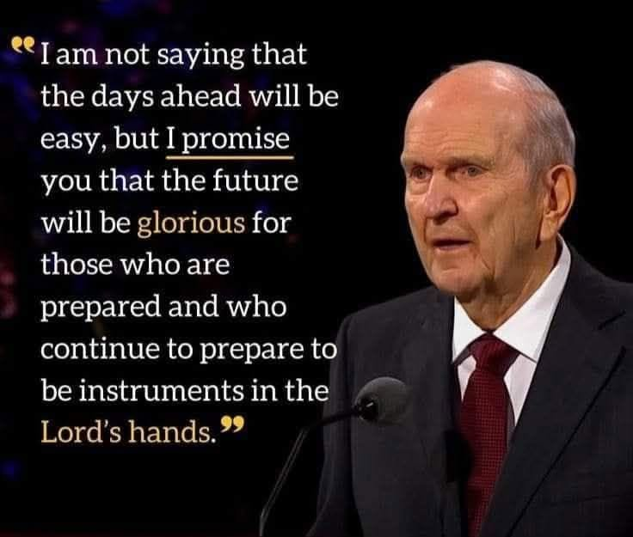
October 2020 Conference

Slide 20
Born with short-term memories
Please feel free to contact me (Noji Ratzlaff)
The Church has a lot of online resources
I will make this slide presentation available

Slide 21
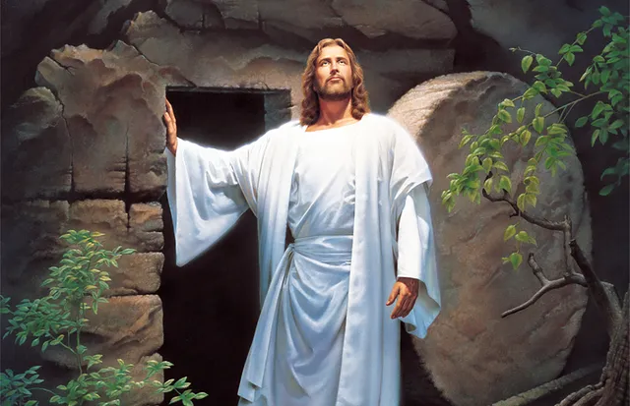
Jesus is the Christ
We’re engaged in His work
The Savior directs the Church through Prophets and other leaders

Slide 22
Thank you

