Slide 1
Ham Radio
Extra Class License
Day 2
Noji Ratzlaff
KNØJI
noji.com/hamradio

Slide 2

HamStudy progress
Show me

Slide 3
What we plan to accomplish today
Cover
E5 : Electrical principles
E4 : Amateur practices

Slide 4
E5 : Electrical principles
Impedance
Reactance and resonance
Plots and coordinate systems
Time constants and phase relationships
Complex power

Slide 5
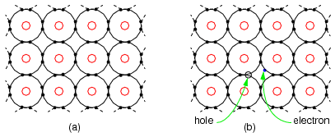
Current flow
In a conductor, electrons flow due to pressure from a voltage source
The movement of electrons leaves “holes” for other electrons to fill
Convention follows the flow of “holes”
Current flows in the opposite direction of electron flow

Slide 6
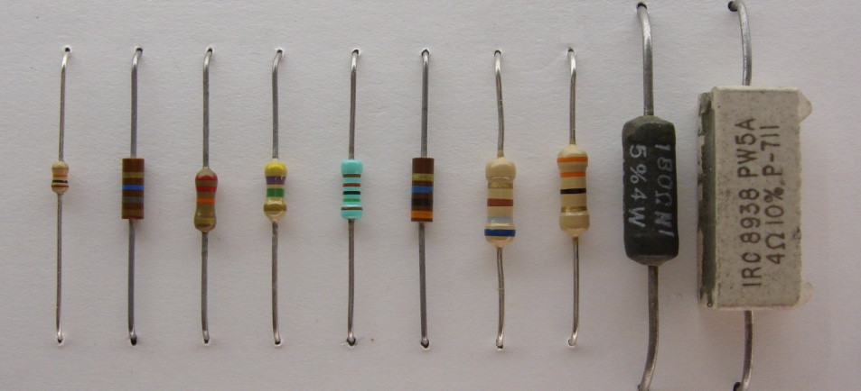
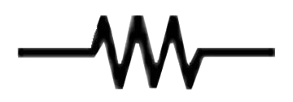
Resistors
Resistance
Measured in ohms (Ω)
Drops voltage
Opposes current flow without regard to frequency
Her

Slide 7
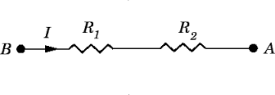
Resistors in series
Values add
R_{total} = R₁ + R₂
If R₁ = 15 Ω and R₂ = 25 Ω, then R_{total} =
40 Ω
Notes:
G5C03 : A resistor in series should be added to an existing resistor to increase the resistance

Slide 8
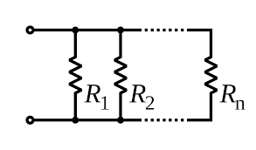
Resistors in parallel
Reciprocal vales add to a reciprocol total
1/R_{total} = 1/R₁ + 1/R₂
If R₁ = 20 Ω and R₂ = 20 Ω, then R_{total} =
10 Ω
Two-resistor shortcut : product over the sum
20 Ω || 30 Ω =
(20 Ω X 30 Ω) / (20 Ω + 30 Ω) = 12 Ω
Notes:
G5C04 : The total resistance of three 100-ohm resistors in parallel is 33.3 ohms
G5C15 : The total resistance of a 10 ohm, a 20 ohm, and a 50 ohm resistor in parallel is 5.9 ohms

Slide 9
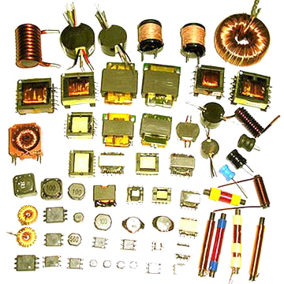

Inductors
Inductance
Measured in henries (H)
Opposes current change
Opposition to current flow increases with frequency

Slide 10
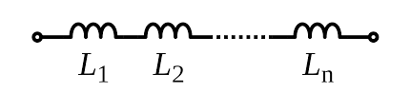
Inductors in series
Values add
L_{total} = L₁ + L₂
If L₁ = 20 mH and L₂ = 50 mH, then L_{total} =
70 mH
Notes:
G5C11 : The inductance of a 20 mH inductor in series with a 50 mH inductor is 70 mH

Slide 11

Inductors in parallel
Reciprocal vales add to a reciprocol total
1/L_{total} = 1/L₁ + 1/L₂
If L₁ = 50 mH and L₂ = 50 mH, then L_{total} =
25 mH
Two-inductor shortcut : product over the sum
20 mH || 30 mH =
(20 mH X 30 mH) / (20 mH + 30 mH) = 12 mH
Notes:
G5C10 : The inductance of three 10 mH inductors connected in
parallel is 3.3 mH

Slide 12
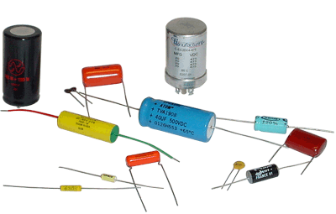
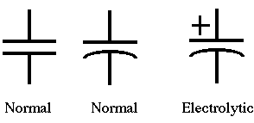
Capacitors
Capacitance
Measured in farads (F)
Opposes voltage change
Opposition to current flow decreases with frequency

Slide 13

Capacitors in series
Reciprocal vales add to a reciprocol total
1/C_{total} = 1/C₁ + 1/C₂
If C₁ = 12 µF and C₂ = 4 µF, then C_{total} =
3 µF
Two-capacitor shortcut : product over the sum
20 µF § 30 µF =
(20 µF X 30 µF) / (20 µF + 30 µF) = 12 µF
Notes:
G5C09 : The capacitance of three 100 microfarad capacitors connected in series is 33.3 microfarads
G5C12 : The capacitance of a 20 microfarad capacitor in series with a 50 microfarad capacitor is 14.3 microfarads

Slide 14
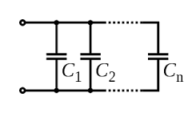
Capacitors in parallel
Values add
C_{total} = C₁ + C₂
If C₁ = 12 µF and C₂ = 4 µF, then C_{total} =
16 µF
Notes:
G5C13 : A capacitor in parallel should be added to a capacitor to increase the capacitance
G5C08 : The equivalent capacitance of two 5.0 nanofarad capacitors and one 750 picofarad capacitor connected in parallel is 10.750 nanofarads

Slide 15
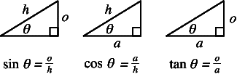
Trigonometry review
The three basic trigonometric functions are ratios, with θ representing some angle
SOH
CAH
TOA
Remember that tanθ = sinθ / cosθ
tan⁻¹(o/a) = θ, sin⁻¹(o/h) = θ, cos⁻¹(a/h) = θ

Slide 16
Impedance
Opposition to AC current flow
Z = R + jX
all units are in ohms (Ω)
R = resistance
X = reactance
Z_{mag} = √(R² + X²) = √[R² + (X_{L} – X_{C})²]
Notes:
G5A01 : Impedance is the opposition to the flow of current in an AC circuit
G5A10 (removed) : Impedance is measured in ohms

Slide 17
Reactance
X = X_{L} – X_{C}
opposition to AC flow caused by inductance or capacitance
X_{L} is called inductive reactance
X_{C} is called capacitive reactance
Notes:
G5A02 : Reactance is opposition to the flow of alternating current caused by capacitance or inductance
G5A03 : Reactance causes opposition to the flow of alternating current in an inductor
G5A04 : Reactance causes opposition to the flow of alternating current in a capacitor
G5A09 : Reactance is measured in ohms

Slide 18
Inductive reactance
X_{L} = ωL = 2πfL (Ω)
(ω = 2πf)
f = frequency (Hz)
L = inductance (H)
as the frequency increases, inductive reactance increases
Notes:
G5A05 : As the frequency of the applied AC to an inductor increases, the reactance increases

Slide 19
Capacitive reactance
X_{C} = 1/ωC = 1/(2πfC) (Ω)
f = frequency (Hz)
C = capacitance (F)
as the frequency increases, capacitive reactance decreases
Notes:
G5A06 : As the frequency of the applied AC to a capacitor increases, the reactance decreases

Slide 20
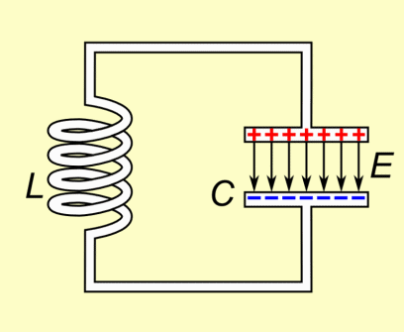
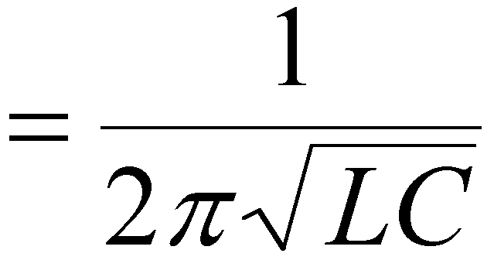

Resonance
X_{L} = X_{C}
Z = R + jX
= R + j(X_{L} – X_{C})
= R
But at what frequency?
Series RLC : input current at maximum
voltages can be larger than the applied
Parallel RLC : input current at minimum
circulating current is at maximum
Notes:
E5A02 : Resonance is the frequency at which the capacitive reactance equals the inductive reactance
E5A03, E5A04 : The magnitude of the impedance of a series RLC circuit at resonance approximately equal to circuit resistance
E5A05 : The current at the input of a series RLC circuit is maximum at resonance
E5A01 : Resonance can cause the voltage across reactances in series to be larger than the voltage applied to them
E5A07 : The current at the input of a parallel RLC circuit is minimum at resonance
E5A06 : The magnitude of the circulating current is at a maximum within the components of a parallel LC circuit at resonance

Slide 21
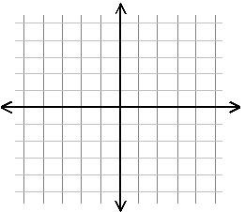
Rectangular coordinates
Impedance
Z = R + jX
Plot R versus X
Real versus imaginary
Notes:
E5C11 : The two numbers that are used to define a point on a graph using rectangular coordinates represent the coordinate values along the horizontal and vertical axes
E5C13 : Rectangular coordinate system is often used to display the resistive, inductive, and/or capacitive reactance components of an impedance
E5C09 : When using rectangular coordinates to graph impedance, the horizontal axis represents the resistive component
E5C10 : When using rectangular coordinates to graph impedance, the vertical axis represents the reactive component

Slide 22
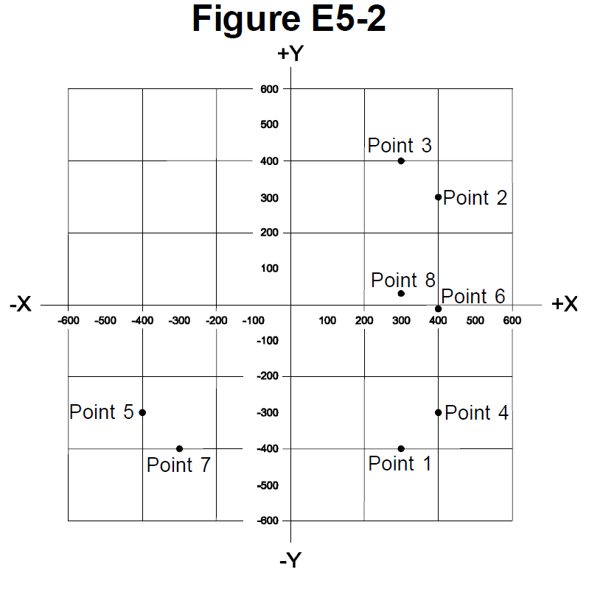
Calculator exercise : plot Z
1. 400 Ω, 38pF,
14 MHz
Point 4
2. 300 Ω, 18 µH,
3.505 MHz
Point 3
3. 300 Ω, 19 pF,
21.200 MHz
Point 1
Notes:
E5C10 : 400 ohm resistor and a 38 picofarad capacitor at 14 MHz is point 4
E5C11 : 300 ohm resistor and an 18 microhenry inductor at 3.505 MHz is point 3
E5C12 : 300 ohm resistor and a 19 picofarad capacitor at 21.200 MHz is point 1
E5C17 (removed) : 300-ohm resistor, a 0.64-microhenry inductor and an 85-picofarad capacitor at 24.900 MHz is point 8

Slide 23
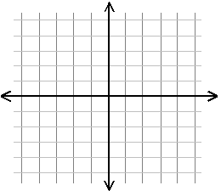
Polar coordinates
Impedance
Still real versus imaginary
Z_{mag} ∠θ
Plot Z_{mag} and angle
Notes:
E5C08 : Polar coordinate system is often used to display the phase angle of a circuit containing resistance, inductive and/or capacitive reactance

Slide 24
Rectangular ― polar conversion
Rect = R + jX
Polar = Z_{mag} ∠θ, where
Z_{mag} = √(R² + X²) and θ = tan⁻¹(X/R)
for series circuits
Z_{mag} = RX/√(R² + X²) and θ = tan⁻¹(R/X)
for parallel circuits
Rect = Z_{mag}cosθ + jZ_{mag}sinθ
Example: put Z = 100 + j100 Ω in polar
141∠45° Ω
Notes:
E5B11 : θ = tan⁻¹(X/R) = tan⁻¹(X_{L}-X_{C}/R) = tan⁻¹[(50-25)/100] = 14 degrees leading (because it’s positive)

Slide 25
Admittance
Y = 1/Z = G + jB
Inverse of impedance
Measured in siemens (S)
Z is impedance (Ω)
Y is admittance (S)
G is conductance (S)
B is susceptance (S)
Notes:
E5B12 : Admittance is the inverse of impedance
E5B13 : B represents susceptance
E5B03 : The phase angle sign is reversed when the reactance is converted to a susceptance
E5B05 : The magnitude of the reactance is the reciprocol of the magnitude of the susceptance when a reactance is converted to a susceptance

Slide 26
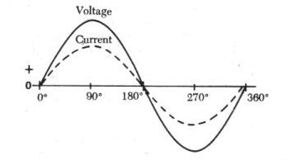
Voltage and current in-phase
Purely resistive
Plot Z = R

Slide 27

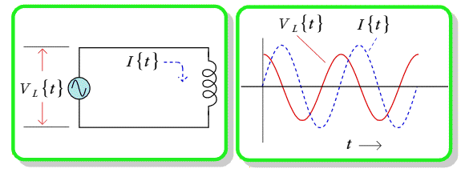
Inductor voltage leads current
Inductor :
voltage leads the current
(current lags the voltage)
90° out of phase
Notes:
E5B10 : The relationship between the current through an inductor and the voltage across an inductor is that the voltage leads the current by 90 degrees

Slide 28

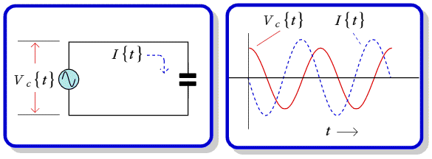
Capacitor current leads voltage
Capacitor :
current leads the voltage
(voltage lags the current)
90° out of phase
Notes:
E5B09 : The relationship between the current through a capacitor and the voltage across a capacitor is that the current leads the voltage by 90 degrees

Slide 29
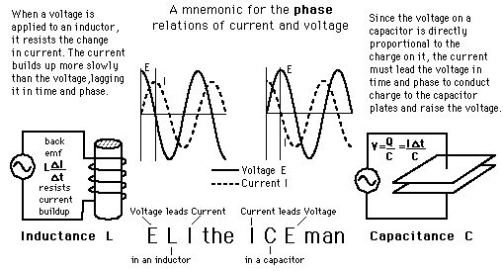
ELI the ICE man
_{E}L_{I} : voltage leads the inductor current
current lags the voltage
_{I}C_{E} : current leads the capacitor voltage
voltage lags the current

Slide 30
Series RLC calculation quiz
R = 1 kΩ X_{L} = 250 Ω X_{C} = 500 Ω
What’s the phase angle?
14.0°, voltage lagging the current
R = 100 Ω X_{L} = 100 Ω X_{C} = 25 Ω
What’s the phase angle?
37.9°, voltage leading the current
Notes:
E5B07 : The phase angle between the voltage across and the current through a series RLC circuit if XC is 500 ohms, R is 1 kilohm, and XL is 250 ohms is 14.0 degrees with the voltage lagging the current

Slide 31
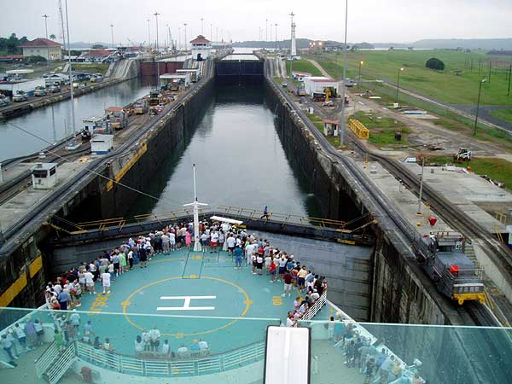
LC charge and discharge

Slide 32
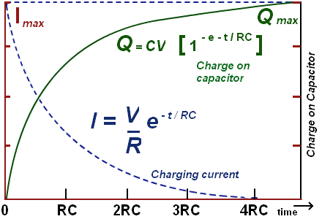
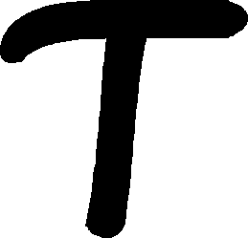
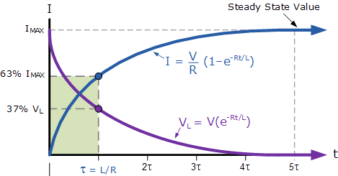
Time constants
Capacitive :
= RC
Series and parallel
Inductive :
= L / R
Series and parallel
Notes:
E5B01 : One time constant is the term for the time required for the capacitor in an RC circuit to be charged to 63.2% of the applied voltage
E5B02 : One time constant is the term for the time it takes for a charged capacitor in an RC circuit to discharge to 36.8% of its initial voltage
E5B03 (removed) : The capacitor in an RC circuit is discharged to 13.5% of the starting voltage after two time constants

Slide 33
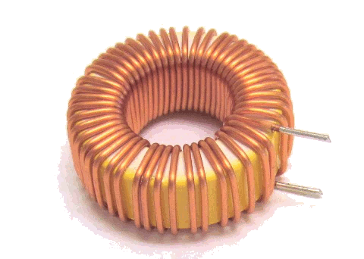
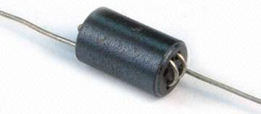

Toroids and beads
Ferrite beads used as VHF / UHF parasitic suppressors of HF amplifiers
Toroidal cores confine most of the magnetic field wthin its core, unlike solenoidal cores
Powdered-iron toroids maintain characteristics at higher currents better than ferrites
Ferrite toroids require fewer turns to produce a given inductance than powdered-iron ones
Notes:
E6D09 : Ferrite beads are commonly used as VHF and UHF parasitic suppressors at the input and output terminals of a transistor HF amplifier
E6D10 : Toroidal cores confine most of the magnetic field within the core material, unlike a sloenoidal core
E6D08 : Powdered-iron toroids generally maintain their characteristics at higher currents
E6D05 : Ferrite toroids generally require fewer turns to produce a given inductance value

Slide 34
Complex power
P_{DC} = IE
= I(IR) = I²R
If Z = R + jX,
P_{AC} = I²Z = I²(R + jX)
= I²R + jI²X (complex power)

Slide 35
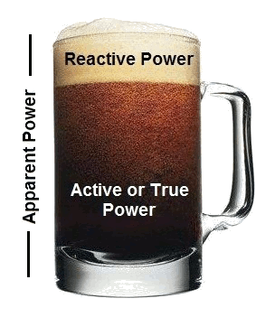
Reactive power
Therefore, P_{mag} = I²Z_{mag}
= I²√(R² + X²) is called apparent power
For P_{AC} = I²Z
= I²(R + jX)
= I²R + jI²X
I²R is called real or true power
because it’s the actual
power that’s consumed
I²X is called reactive power
Reactive power is not dissipated
Reactive power is not productive
Notes:
E5D14 : Reactive power is wattless, nonproductive power
E5D09 : Reactive power in an AC circuit that has both ideal inductors and ideal capacitors is repeatedly exchanged between the associated magnetic and electric fields, but is not dissipated

Slide 36
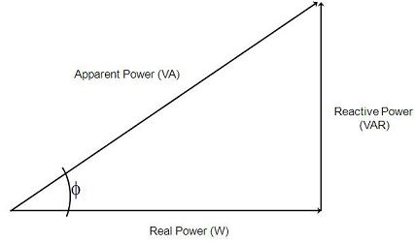
Power triangle
Real (also called active) power is measured in watts (W)
Apparent power is measured in volt-amps (VA)
Reactive power is measured in volt-amps reactive (VAR)
φ is the angle of impedance

Slide 37
Power factor
Ratio of the real power to the apparent power (expressed as a decimal or percent)
Cosine of the impedance angle
If a circuit input is 100 V_{AC} at 4 A (therefore representing its apparent power), and has a power factor of 0.2, the circuit is consuming how much?
(100 V)(4 A)(0.2) = 80 W
Notes:
E5D11 : The power factor of an R-L circuit having a 60 degree phase angle between the voltage and the current is 0.5
E5D12 : 80 watts are consumed in a circuit having a power factor of 0.2 if the input is 100-V AC at 4 amperes
E5D18 : 355 W are consumed in a circuit having a power factor of 0.71 if the apparent power is 500 VA

Slide 38
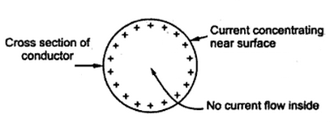
Skin effect
As frequency increases, RF current flows in a thinner layer of the conductor, closer to the surface
Notes:
E5D01 : The result of skin effect is that as frequency increases, RF current flows in a thinner layer of the conductor, closer to the surface
E5D02 (removed) : The resistance of a conductor different for RF currents than for direct currents because of skin effect

Slide 39
E4 : Amateur practices
Noise
Interference and other problems
Resolving noise and interference problems
Receiver performance characteristics
Test equipment
Measurement technique and limitations

Slide 40
Electrical noise
Alternator
Can be solved by
Direct battery power and coaxial (inline) capacitors
Electric motor
Can be solved by
Brute-force AC-line filter
Notes:
E4E04 : Conducted and radiated noise caused by an automobile alternator can be suppressed by connecting the radio's power leads directly to the battery and by installing coaxial capacitors in line with the alternator leads
E4E05 : Noise from an electric motor can be suppressed by installing a brute-force AC-line filter in series with the motor leads

Slide 41
House noise
How to test for it coming from your home
Turn off all AC and listen by battery
Electrical wiring near an antenna picks up
Common-mode signal at the RF frequency
Loud roaring or buzzing AC interference
Thermostat, doorbell, or advertising sign
Unstable modulation at some frequencies
Nearby personal computer
Notes:
E4E07 : How you can determine if line noise interference is being generated within your home is by turning off the AC power line main circuit breaker and listening on a battery operated radio
E4E08 : A common-mode signal at the frequency of the radio transmitter is picked up by electrical wiring near a radio antenna
E4E13 : A loud roaring or buzzing AC line interference that comes and goes at intervals can be caused by arcing thermostat contacts, defective doorbell or doorbell transformer, or a malfunctioning illuminated advertising display
E4E14 : Unstable modulated or unmodulated signals at specific frequencies can be caused by a nearby personal computer

Slide 42
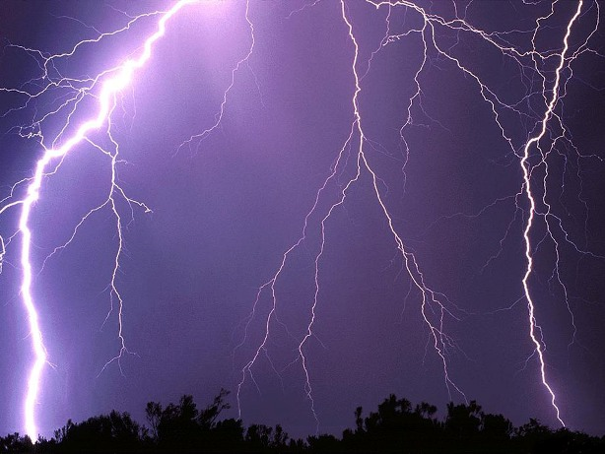
Atmospheric noise
Primary source of HF receiver noise
Thunderstorms are a major cause
Notes:
E4C15 : Atmospheric noise is the primary source of noise that can be heard from an HF receiver with an antenna connected
E4E06 : Thunderstorms are a major cause of atmospheric static

Slide 43
Other noise sources
Touch controlled device
AC hum on an AM receiver
Drifts slowly across the HF spectrum
Can be several kHz in width
Combinations of local AM broadcasts on HF bands
Nearby corroded metal joints are mixing and re-radiating the broadcasts
Notes:
E4E10 : Interference caused by a touch controlled electrical device sounds like AC hum on an AM receiver, may drift slowly across the HF spectrum, and can be several kHz in width
E4E11 : If you are hearing combinations of local AM broadcast signals within one or more of the MF or HF ham bands, nearby corroded metal joints are mixing and re-radiating the broadcast signals

Slide 44
Resolving noise problems
DSP noise filter
Reduces broadband white noise, ignition noise, and power line noise
DSP on CW however
Can also remove the desired signal
Roofing filter
Improves dynamic range by attenuating strong nearby signals
Notes:
E4E02 : Broadband white noise, ignition noise, and power line noise can often be reduced with a DSP noise filter
E4E12 : One disadvantage of using some types of automatic DSP notch-filters when attempting to copy CW signals is the DSP filter can remove the desired signal at the same time as it removes interfering signals
E4C13 : A narrow-band roofing filter affects receiver performance in that it improves dynamic range by attenuating strong signals near the receive frequency

Slide 45
Noise blanker
A receiver noise blanker might be able to remove signals that appear across a wide bandwidth
Ignition noise can often be reduced by use of a noise blanker
Noise blanker side-effect
Nearby legal signals can appear excessively wide
Notes:
E4E01 : Ignition noise can often be reduced by use of a receiver noise blanker
E4E03 : A receiver noise blanker might be able to remove signals which appear across a wide bandwidth from desired signals

Slide 46
Image interference
Mirror-image of a signal around the IF
Receiver with 455 kHz IF tuned to 14.300 MHz might get a spurious image from
15.210 MHz
To eliminate image signal interference
Front-end filter or pre-selector
Why select high frequency for the IF?
Easier to eliminate image responses
Notes:
E4C14 : Spurious image signal from 15.210 MHz can be generated in a receiver tuned to 14.300 MHz and which uses a 455 kHz IF frequency
E4C02, E4D09 : A front-end filter or pre-selector of a receiver can be effective in eliminating image signal interference
E4C09 : A good reason for selecting a high frequency for the design of the IF in a conventional HF or VHF communications receiver is that it is easier for front-end circuitry to eliminate image responses

Slide 47
Desensitization
Reduction in receiver sensitivity caused by a strong, nearby frequency
Decrease RF bandwidth to reduce the likelihood of receiver desensitization
Notes:
E4D12 : Desensitization is the reduction in receiver sensitivity caused by a strong signal near the received frequency
E4D13 : Strong adjacent-channel signals can cause receiver desensitization
E4D14 : Decrease the RF bandwidth of the receiver to reduce the likelihood of receiver desensitization

Slide 48
Receiver noise figure
Theoretical noise floor (minimum)
-174 dBm/Hz
Noise figure
Ratio of receiver noise to theoretical minimum noise
For a perfect receiver with 400 Hz noise bandwidth, unmodulated carrier input is
-148 dBm
Lowering the noise figure
Improves weak signal sensitivity
Notes:
E4C05 : -174 dBm/Hz represents the theoretical noise at the input of a perfect receiver at room temperature
E4C04 : The noise figure of a receiver is the ratio in dB of the noise generated by the receiver compared to the theoretical minimum noise
E4C06 : The level of an unmodulated carrier input to a receiver that would yield an audio output SNR of 0 dB in a 400 Hz noise bandwidth is -148 dBm
E4C08 (removed, but left in the notes for the effect) : Lowering the noise figure affects receiver performance by improving weak signal sensitivity

Slide 49
Receiver dynamic range
Dynamic range
Difference between the smallest and largest discernible signal
Blocking dynamic range
Difference between the noise floor and an incoming signal that will cause 1 dB of gain compression
Poor dynamic range causes
Cross-modulation
Desensitization
Notes:
E4D01 : The blocking dynamic range of a receiver is the difference in dB between the noise floor and the level of an incoming signal which will cause 1 dB of gain compression
E4D02 : Two problems caused by poor dynamic range in a communications receiver are cross-modulation of the desired signal and desensitization from strong adjacent signals

Slide 50
Intermodulation interference
Unwanted signals generated by the mixing of two or more signals
Can occur with two repeaters in close proximity and their signals mix
A properly terminated circulator at the transmitter output can eliminate IMI
In a circuit, IMI can be caused by nonlinear circuits or devices
Notes:
E4D06 : Intermodulation interference is the term for unwanted signals generated by the mixing of two or more signals
E4D03 : Intermodulation interference between two repeaters can occur when the repeaters are in close proximity and the signals mix in the final amplifier of one or both transmitters
E4D04 : A properly terminated circulator at the output of the transmitter may reduce or eliminate intermodulation interference in a repeater caused by another transmitter operating in close proximity
E4D08 : Nonlinear circuits or devices causes intermodulation in an electronic circuit

Slide 51
Intermodulation products
fmod = 2fn – f1 = 2f2 – fn
Given fmod = 146.70 MHz, fn = 146.52 MHz
f₁ = 146.34 MHz, f₂ = 146.61 MHz
A third-order intercept level of 40 dBm means a pair of 40 dBm signals will generate a third-order IM product with the same level
Third-order IM products created within a receiver are likely also in the band
Notes:
E4D05 : 146.34 MHz and 146.61 MHz transmitter frequencies would cause an intermodulation-product signal in a receiver tuned to 146.70 MHz when a nearby station transmits on 146.52 MHz
E4D10 : With respect to receiver performance a third-order intercept level of 40 dBm means a pair of 40 dBm signals will theoretically generate a third-order intermodulation product with the same level as the input signals
E4D11 : Third-order intermodulation products are created within a receiver of particular interest compared to other products because the third-order product of two signals which are in the band of interest is also likely to be within the band

Slide 52
Other problems
Cross-modulation
Heard in addition to your desired signal
Capture effect
Blocking one FM signal by a stronger one
Notes:
E4E09 : Nearby signals may appear to be excessively wide even if they meet emission standards is an undesirable effect that can occur when using an IF noise blanker
E4D07 : The most significant effect of an off-frequency signal when it is causing cross-modulation interference to a desired signal is that the off-frequency unwanted signal is heard in addition to the desired signal
E4C03 : Capture effect is the term for the blocking of one FM phone signal by another, stronger FM phone signal

Slide 53
Receiver selectivity
Desired selectivity for a RTTY receiver
300 Hz
Desired selectivity for an SSB receiver
2.4 kHz
Too wide a filter bandwidth can cause
Undesired signals to be heard
MDS
Minimum discernible signal
Notes:
E4C10 : 300 Hz is a desirable amount of selectivity for an amateur RTTY HF receiver
E4C11 : 2.4 kHz is a desirable amount of selectivity for an amateur SSB phone receiver
E4C12 : Using too wide a filter bandwidth in the IF section of a receiver can cause undesired signals to be heard
E4C07 : MDS of a receiver represents the minimum discernible signal

Slide 54
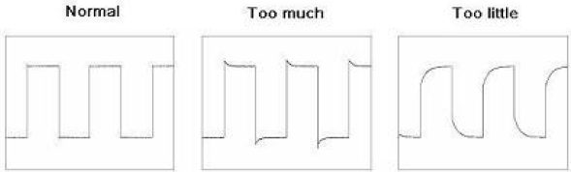
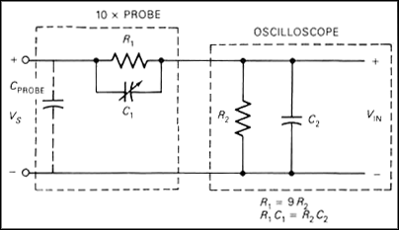
Oscilloscope
Used for detailed analysis of signals
Be sure to keep the probe ground short
Probe compensation adjusted by flattening the horizontal portions of a square wave
Notes:
E4A11 : Keeping the signal ground connection as short as possible is good practice when using an oscilloscope probe
E4A13 : The compensation of an oscilloscope probe is typically adjusted by displaying a square wave and adjusting the probe until the horizontal portions of the displayed wave are as nearly flat as possible

Slide 55
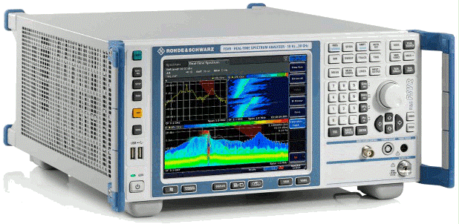
Spectrum analyzer
Displays signals in the frequency domain
Horizontal axis is frequency, vertical axis is amplitude (power)
Displays spurious transmitter signals
Can display intermodulation distortion products for SSB
Notes:
E4A02 : A spectrum analyzer displays frequency on the horizontal axis and amplitude on the vertical axis
E4A03 : A spectrum analyzer is used to display spurious signals from a radio transmitter
E4B10 : A spectrum analyzer is used to display intermodulation distortion products in an SSB transmission

Slide 56
Frequency counter
Used for measuring frequency accurately
Time base accuracy affects counter most
For 146.52 MHz and +/- 1.0 ppm accuracy
146.52 Hz
For 146.52 MHz and +/- 0.1 ppm accuracy
14.652 Hz
For 146.52 MHz and +/- 10 ppm accuracy
1465.20 Hz
Notes:
E4B01 : Time base accuracy is a factor that most affects the accuracy of a frequency counter
E4B03 : If a frequency counter with a specified accuracy of +/- 1.0 ppm reads 146,520,000 Hz, the most the actual frequency being measured could differ from the reading is 146.52 Hz
E4B04 : If a frequency counter with a specified accuracy of +/- 0.1 ppm reads 146,520,000 Hz, the most the actual frequency being measured could differ from the reading is 14.652 Hz
E4B05 : If a frequency counter with a specified accuracy of +/- 10 ppm reads 146,520,000 Hz, the most the actual frequency being measured could differ from the reading is 1465.20 Hz

Slide 57
End of Day 2
Your homework:
Master E4 and E5 on HamStudy
See you next week

Slide 58
Skipped slides
The slides that follow were removed from the main presentation in the interest of time, but are included here for future consideration or to complete your study of the applicable sub-elements

Slide 59
Electromagnetic field
Magnetic field created by an electric current
Magnetic field is directional, and is oriented according to the left-hand rule for electron flow (right-hand rule for current flow)
The current determines the strength of the magnetic field around an inductor
Potential energy can be stored in an electromagnetic or electrostatic field
Notes:
E5D05 (removed) : Electric current creates a magnetic field
E5D06 : The magnetic field oriented about a conductor in relation to the direction of electron flow is in a direction determined by the left-hand rule
E5D07 : The amount of current determines the strength of a magnetic field around a conductor
E5D08 : Potential energy is stored in an electromagnetic or electrostatic field

Slide 60
Electrostatic field
A capacitor stores energy in an electrostatic field
The unit of measure for electrical energy is the Joule
Potential energy can be stored in an electrostatic field
Notes:
E5D03 (removed) : A capacitor is a device used to store electrical energy in an electrostatic field
E5D04 (removed) : Joule is the unit to measure electrical energy stored in an electrostatic field
E5D08 : Potential energy is stored in an electromagnetic or electrostatic field

