Slide 1
Satellite Operation
Noji Ratzlaff
KNØJI
noji.com/hamradio

Slide 2
Satellites
A variety of satellite types
We’re addressing artificial satellites that orbit the Earth
More specifically, amateur radio satellites
BTW, the ISS is also a satellite

Slide 3
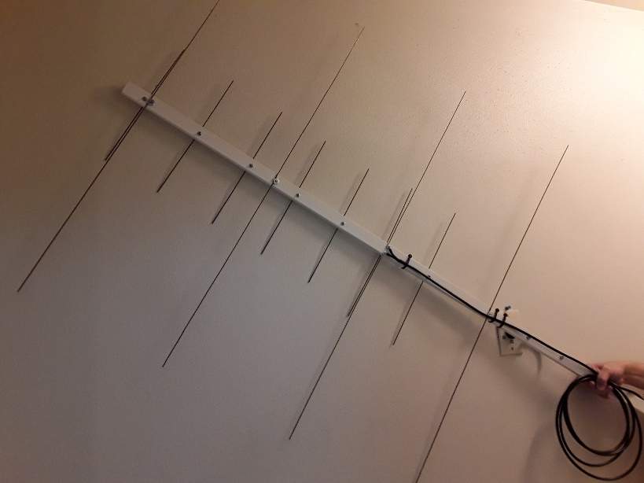
Our goal
Because each satellite contains a repeater
The objective is to use a satellite to make a contact with another ham
Start by making a
dual-band antenna
Here’s the link

Slide 4
Your tasks
Here are the steps (link to the steps):
Install the Heavens-Above app
Determine your grid square
Decide on a satellite
Collect the satellite info
Set up your radio
Rehearse the sweep
Make a contact

Slide 5
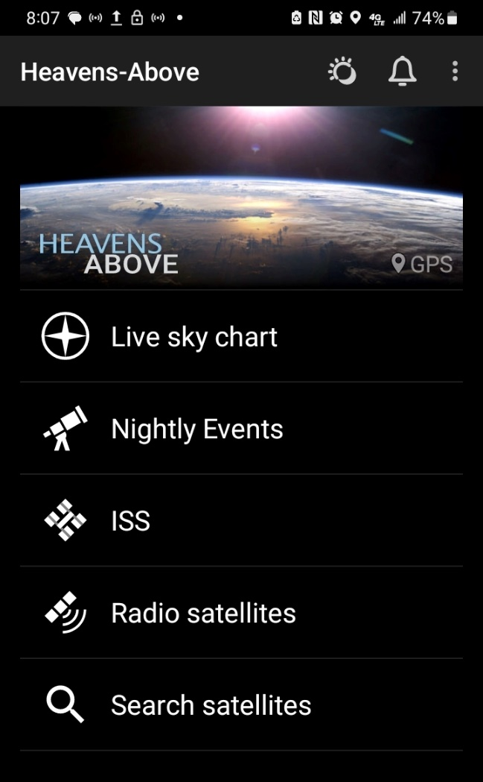
Install Heavens-Above
There are others, but this one’s my favorite
Go to your app store and download it (free)
Start the app
Tap Radio satellites and scroll
Some list only downlink; seek both uplink and downlink
Dates and times are local 24-hour, not UTC

Slide 6
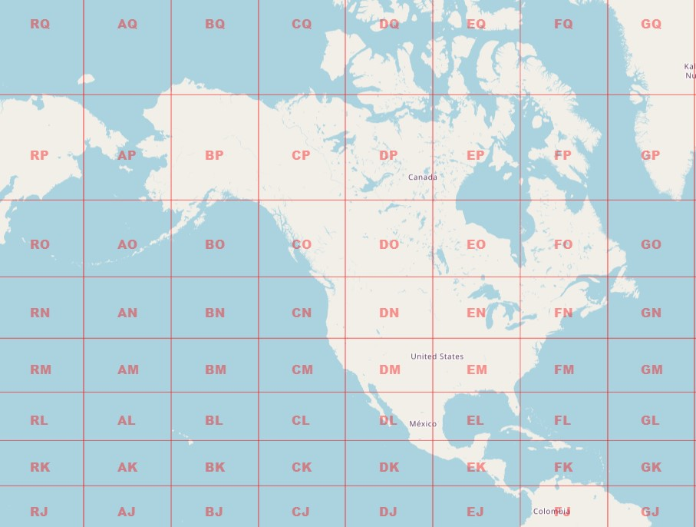
Determine your grid square
The Earth is divided into “squares”
This website is egloff.eu/qralocator

Slide 7
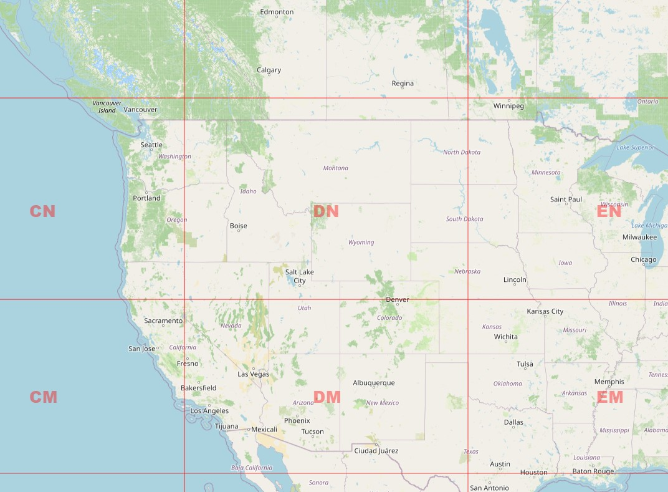
Determine your grid square
We’re in DN

Slide 8
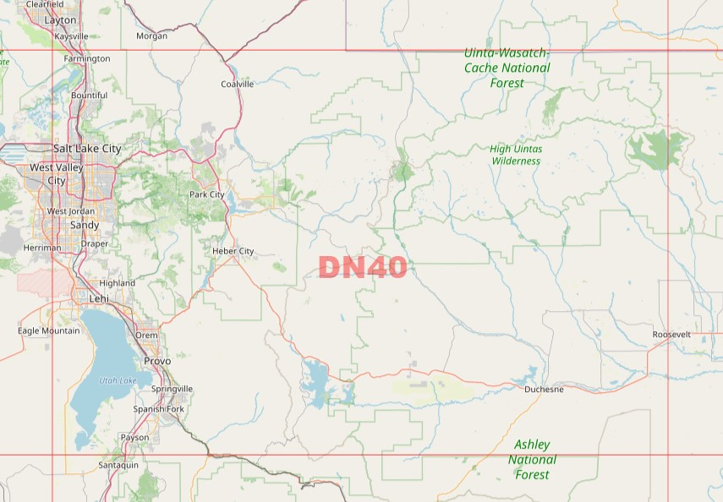
Determine your grid square
We’re in DN40

Slide 9
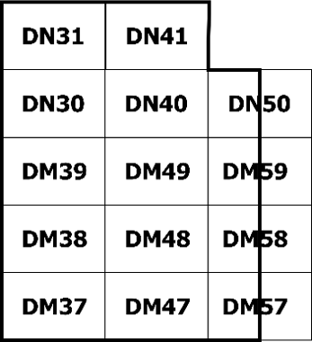
Determine your grid square
Utah view

Slide 10
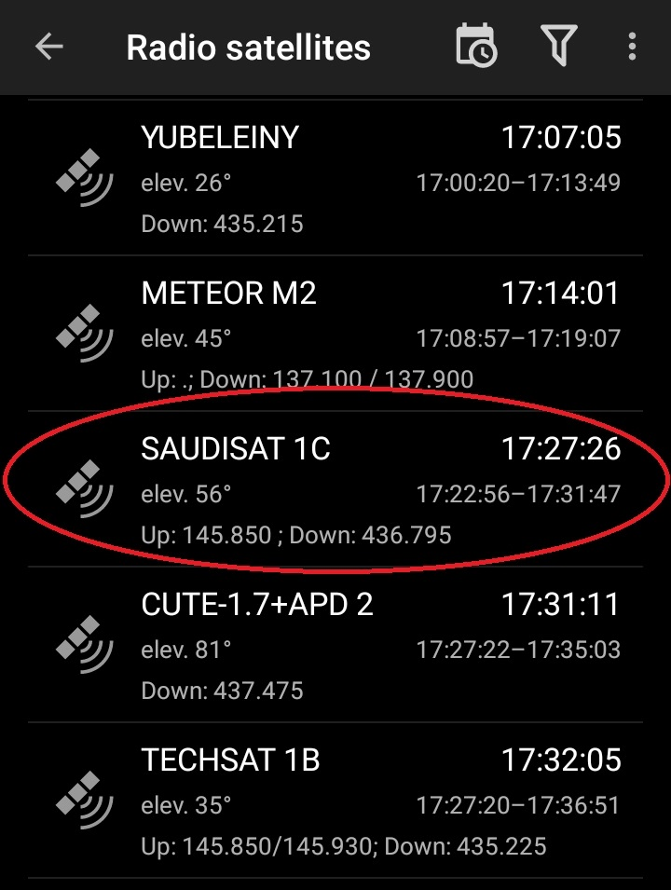
Decide on a satellite
Start with the date
Pick one with
high elevation
both Up and Down
Note the time window

Slide 11
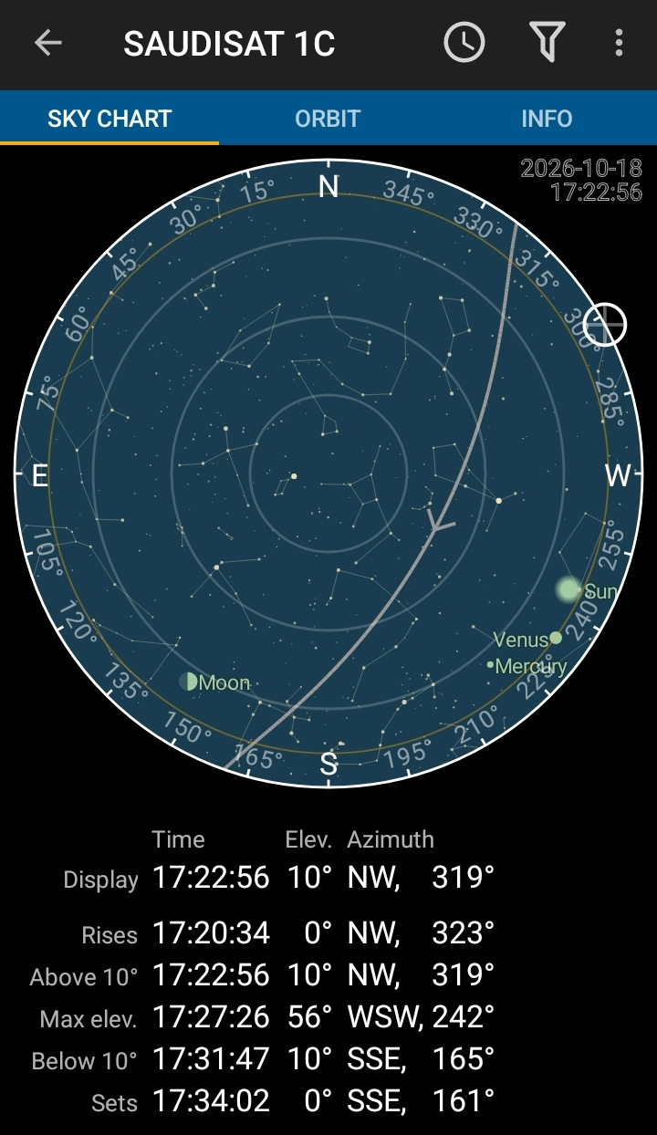
Collect the satellite info
Tap SKY CHART to show the chart and window

Slide 12
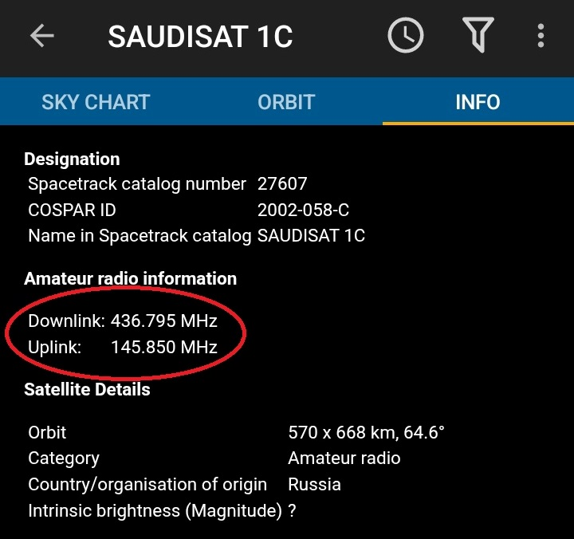
Collect the satellite info
Tap INFO to show its information
Downlink frequency
Uplink frequency

Slide 13
Set up your radio
Not all radios can support satellite features
Must be capable of 290.960 MHz offset
Must be dual-band and dual-watch
Turn on dual-watch (TDR)
Turn off the squelch
Calculate the Doppler shift offsets in both positive and negative directions for the downlink, about 5 kHz apart
Most Baofeng HTs and Yaesu VX-8R can

Slide 14
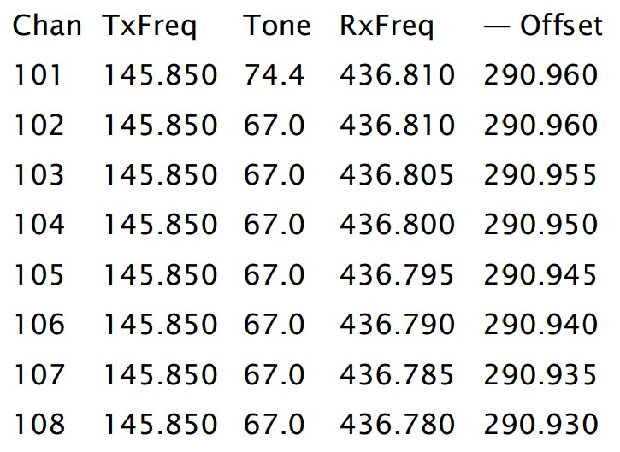
Set up your radio
Program eight channels as follows:

Slide 15
Rehearse the sweep
Determine the sweep time and elevation
Divide the time into four time segments
Practice the sweep
With only the antenna
With antenna and radio
With both while switching channels
With both, switching channels, and saying
K-I-7-A-B-C, D-N-4-0
(my comma indicates a brief pause)

Slide 16
Make a contact
Enable the satellite repeater (Channel 101 for two seconds) or if it’s already in use
Call on Channel 102 as follows:
K-I-7-A-B-C, D-N-4-0 (phonetics)
The other person replies
N-6-D-L-O, D-M-6-9 (phonetics)
You repeat and conclude (no phonetics)
roger, roger, N6DLO, thanks for DM69
Ta-dah!

Slide 17
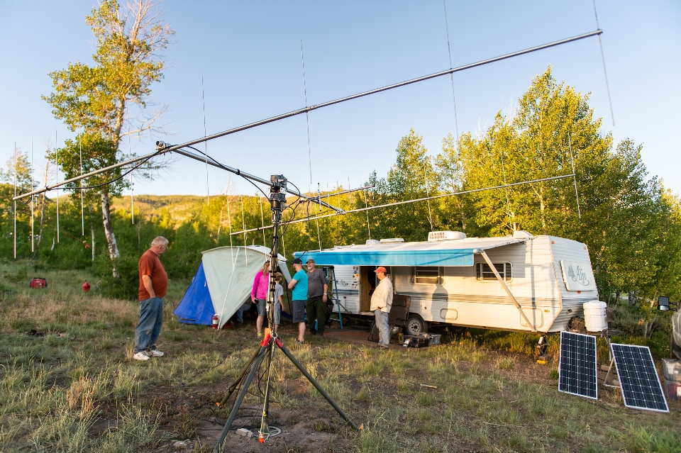
If you have the means
Full-scale satellite station

Slide 18

Feel free to contact me
Noji Ratzlaff KNØJI
nojiratz@hotmail.com

