Slide 1
Lightning Protection
Noji Ratzlaff
KNØJI
noji.com/hamradio

Slide 2
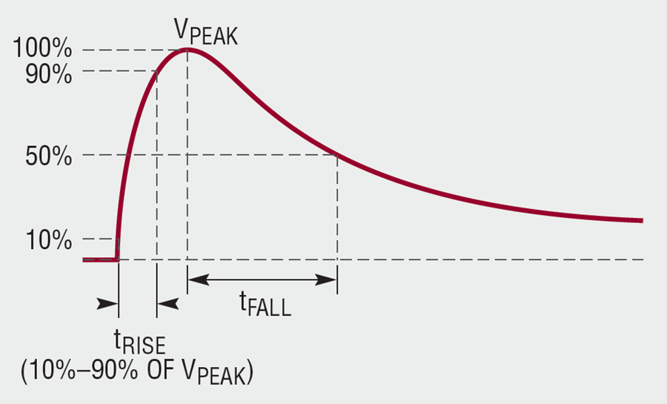
What is lightning?
Massive static discharge
Neither AC nor DC – it’s a transient
Multiple bursts of electrical energy

Slide 3
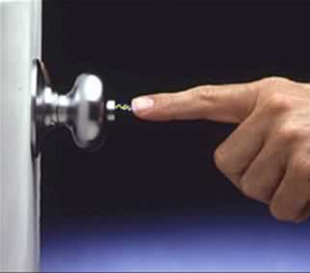
What is static electricity?
Free electrons
Flow of electrons
Lots of electrons
Electrical energy
Atomic conduction band

Slide 4
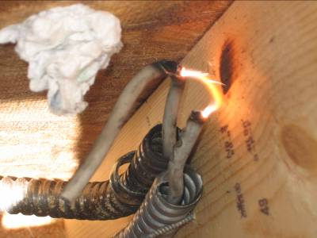
How static is generated
Free electrons accumulate
Proximity, not friction collects static charges
Spark created by conductive air that’s ionized by the electric field
At STP, electrical energy arcs at ~3000 V/mm

Slide 5
Atmospheric static discharge
Accumulation of charge results in electric potential difference
Air between the different potential locations ionize
The air tends to ionize in “clumps” or sections, called leaders
Once the path is formed, the charges start flowing and energy is transferred

Slide 6
Lightning behavior
Many reports of odd or unpredictable behavior
Lightning doesn’t seem to follow the rules
Rest assured, lightning obeys the laws of physics
Then why would lightning take the path of greater resistance?
Kirchoff’s Current Law
Because what might seem like least resistance to us might not actually be the least
Like all electricity, lightning follows all paths, inversely proportional to the path impedance

Slide 7
High-frequency components
Lightning is made of not just one, but numerous transient pulses
Many of these pulses have high-frequency components
High frequency components in conductors result in skin effect
Skin effect results in less conductor cross-section through which current can flow
Less conductor path results in higher conductor impedance
If the impedance of one exposed conductor is high enough, much of the lightning current will often arc to another conductor

Slide 8
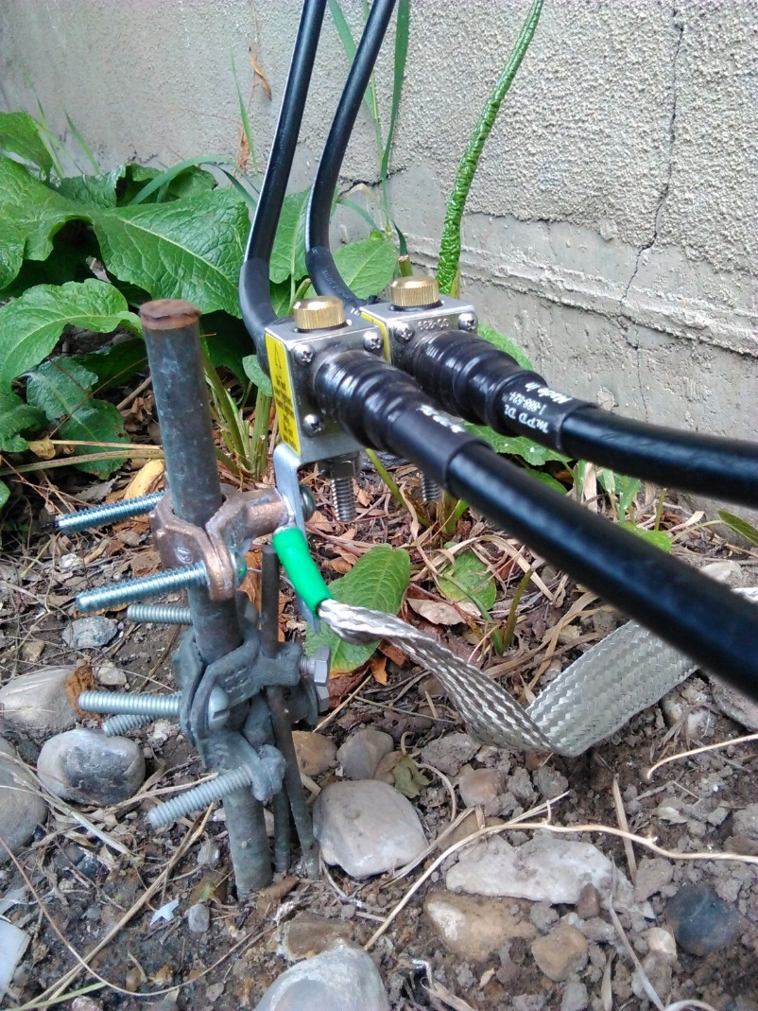
Unplug or leave plugged in?
If you route your coax through a surge protector (“lightning arrester”), plugged or unplugged doesn’t matter
If you do not use a surge protector, unplugging is more dangerous than leaving it plugged in

Slide 9
Direct strike
Lightning “strikes” come in a variety of severities
If I scuff my shoes on the carpet and touch your nose, would you consider that spark lightning? Why or why not?
If I pocketed a 10¢ piece of gum, am I a thief?
What if I pocketed a diamond necklace instead?

Slide 10
Popular lightning myths
Lightning takes the path of least resistance
My antenna will attract lightning
Metallic structures attract lightning
Grounding makes lightning more attractive
Lightning only strikes the tallest objects
Lightning victims can become electrified

Slide 11
Popular lightning protection myths
If it’s not raining, lightning won’t form
If you get caught in an electrical storm, seek shelter under a tree
If you get caught in an electrical storm, crouch down to reduce your chances of being struck
If an electrical storm approaches, find shelter in a baseball dugout, a gazebo, or your front porch
Once I install my grounding system, I’m 100% protected from lightning

Slide 12
Equipment lightning protection
Ensure all potential lightning paths are as large as you can practically get them
Ground rod below each antenna mast
Ground rod just outside your shack
Install a surge protector for each coax run
Connect solid 4 AWG wire between the rods and your service ground (called bonding)
Bond metal enclosures and other potential lightning paths that normally do not carry electrical energy

Slide 13
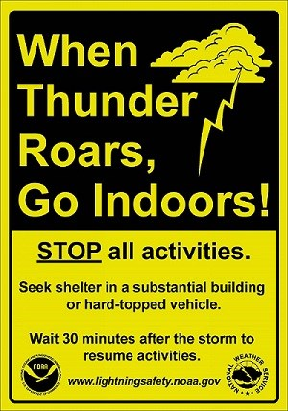
Personal lightning protection
When thunder roars, go indoors
Don’t stand outside near utility poles, towers, guy wires
Don’t seek shelter in open structures or your porch
Don’t stand under trees
Avoid open water
Don’t bathe or shower near plugged-in appliances

Slide 14
